Slide 1
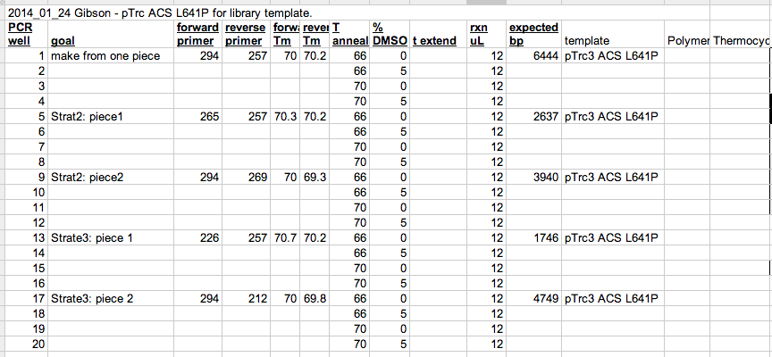
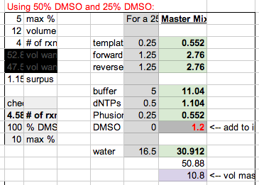
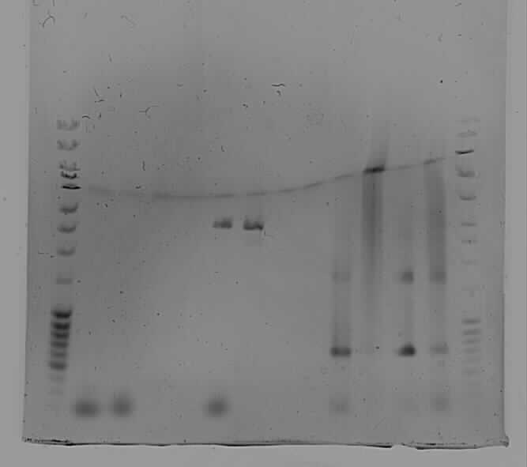
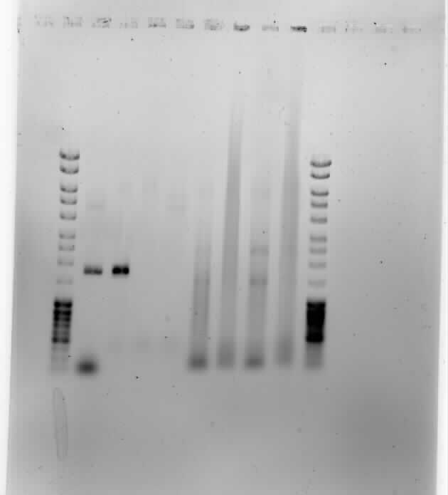
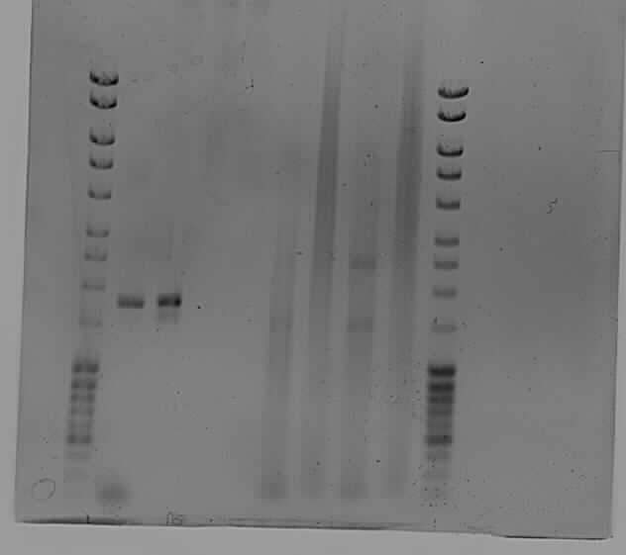
Strategy 2
Piece 2
3.9kb
Got nothing
Strategy 3 piece 1
Strategy 3 piece 2
Wanted 4.7kb
Got nothing
Try Strat2 piece 2 and Strat3 piece 3 again
As one piece
Strategy 2
Piece 1
2.6kb

Slide 2
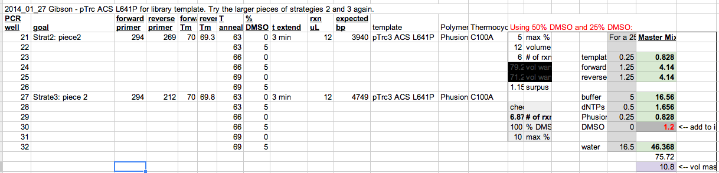
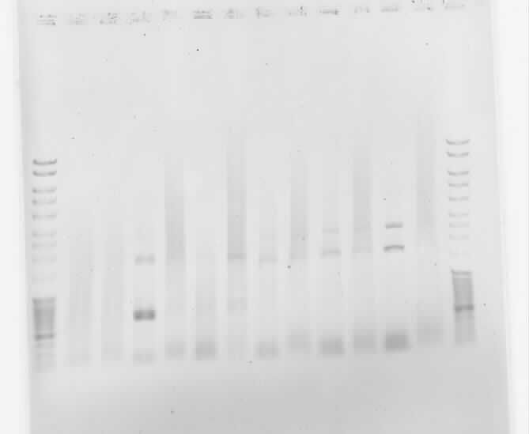
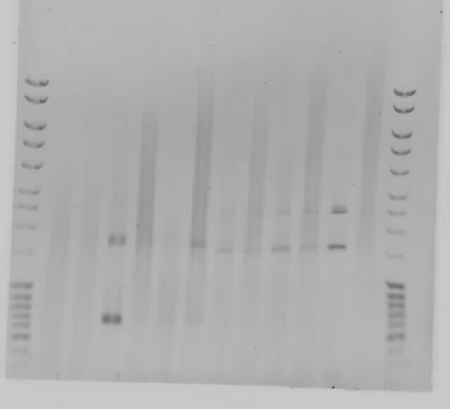

Slide 3
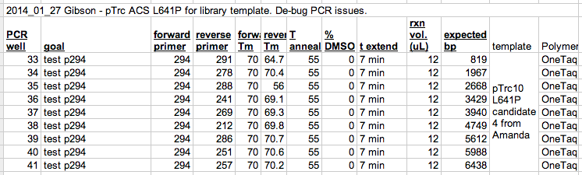
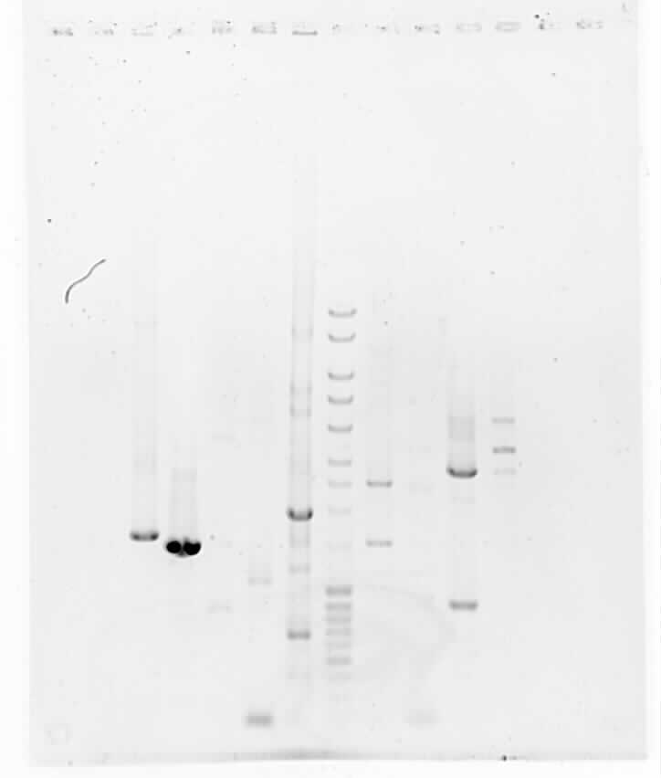
None of this worked! Try again with a brand new stock of primer 294
Well 41
6.4kb
Well 40
6.0kb
Well 39
5.6kb
Well 37
3.9kb
Well 38
4.7kb
Well 36
3.4kb
Well 35
2.6kb
Well 34
1.9kb
Well 33
819bp

Slide 4
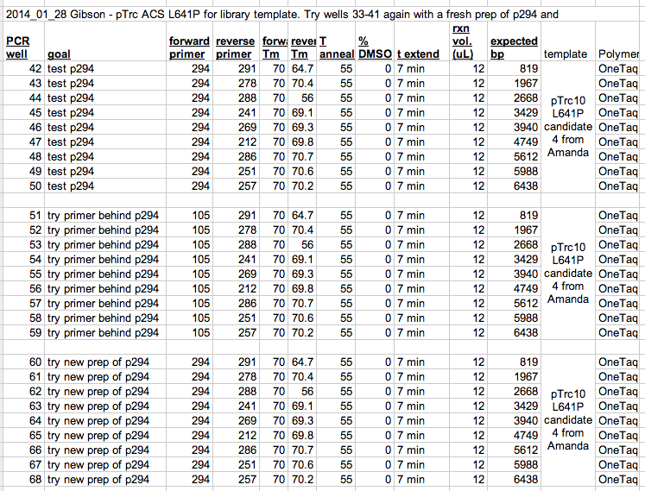
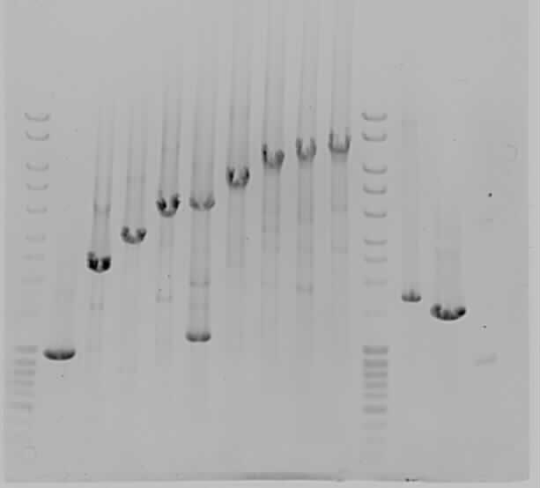
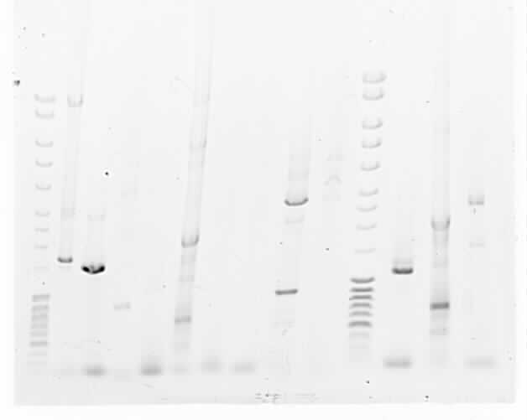
Wells 51-59
Primer 105 works
Wells 60-68
Primer 294 doesn’t work
Wells 45-47
Wells 42-44

Slide 5
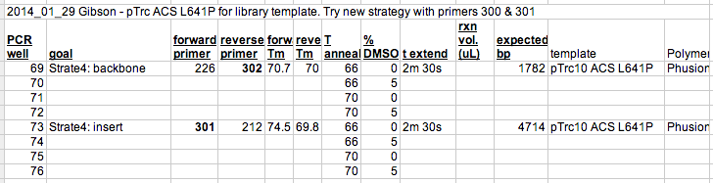
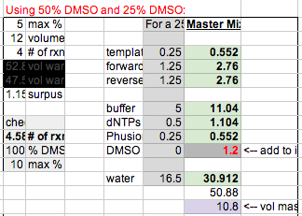
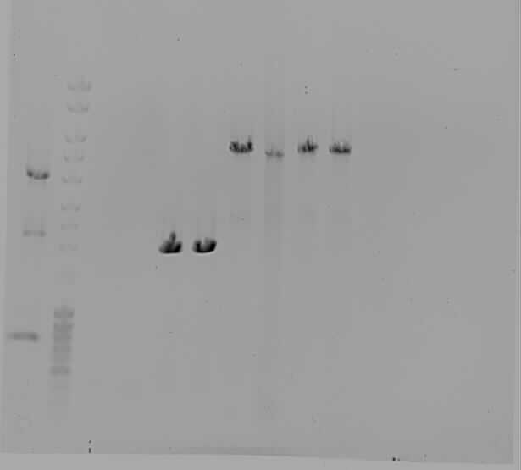
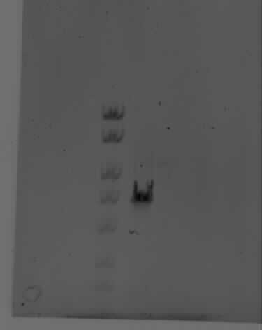
Try new strategy with primers 300 and 301
Re-ran a little of well 74 to check size. It looks a little big but I’m not worried about it yet.
One pair of tubes wasn’t in the strip holder position when I opened it, but I think it was 73&74 which amplified fine so it probably popped out when the lid opened.
Strategy 4 insert seems a little big, but I double checked that 4714 bp is what was expected. Run gel a little longer and see if it looks like it is below the 5kb line.
Anyway, make more PCR product for assembly later.
5000
? Too big?
4000
3000
2000
5000
4000

Slide 6

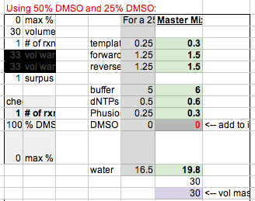
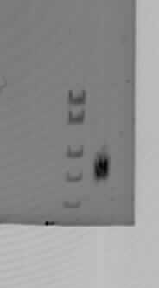
Accidentally ran the products too long on the gel (47 min!) so wait until after PCR cleanup to see results.

Slide 7
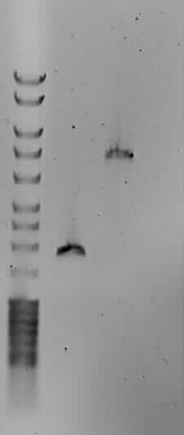
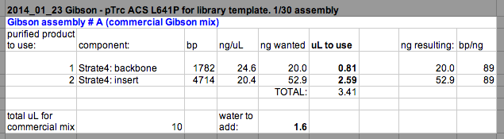
~1.5uL from nano drop

Slide 8
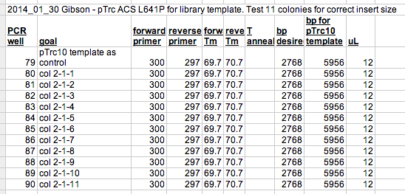
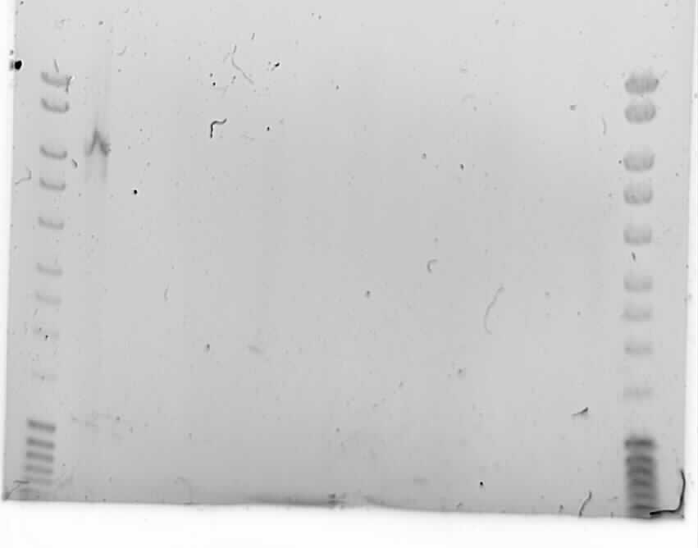
Colonies probably weren’t actually Amp resistant.

Slide 9
